Slide 1
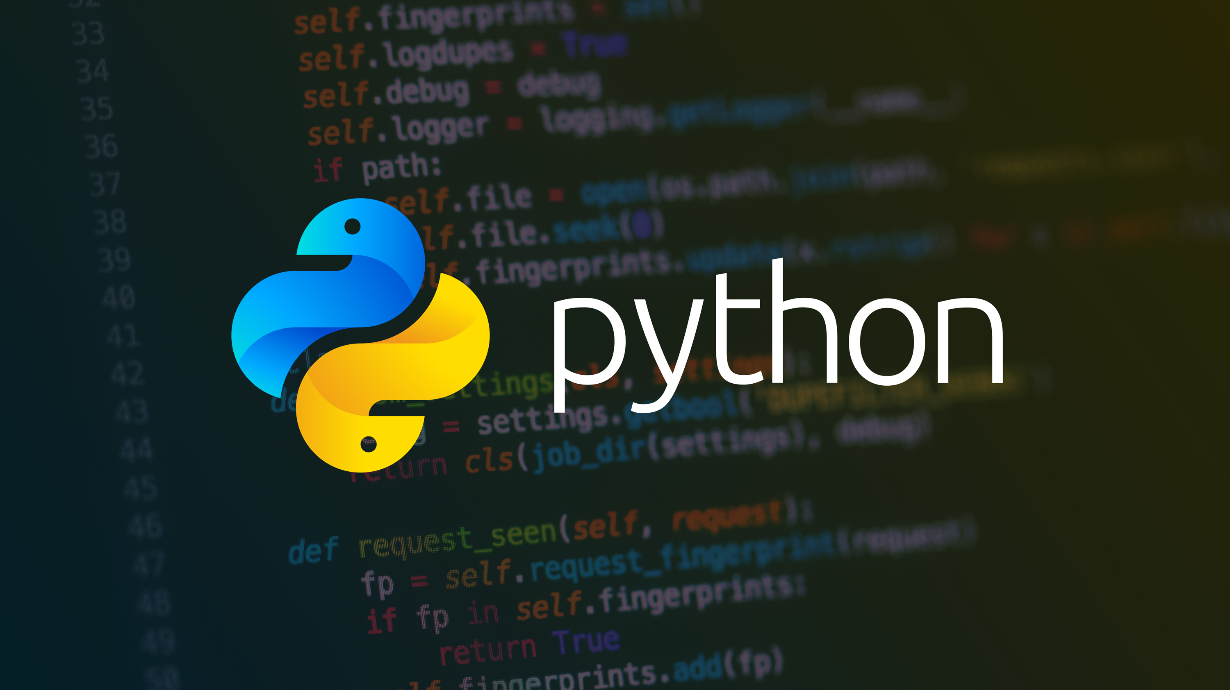
basics

Slide 2

Agenda
Day 2
Working with strings
Working with operators
If statements
Working with Lists
02

Slide 3
04 Working With Strings
05 Working With Operators
06 If Statements
07 Lists
08 While Loops
09 For Loops
10 Range Function
11 Tuples/Dictionaries
12 File IO
13 Error Handling
14 Functions
15 Classes
16 Command line arguments

Slide 4
Strings in Python
Working with Strings
Let’s take the following line of code:
course = "Python for beginners"
This line of code creates a string object. String object has a lot of capabilities. There are a lot of general-purpose functions that exist as a part of the string object.
To see a list of available string object functions, see the following url:
https://www.w3schools.com/python/python_ref_string.asp
Most IDEs will display functions and properties that exist as a part of the defined object when you type the object.
Ex: course.
Try this code:
course = "Python for beginners“ print(course.upper()) print(course.find('y’)) print(course.find('Y’)) print(course.replace('for','4’))
Results
PYTHON FOR BEGINNERS # upper() converts entire string to upper-case
1 # find() searches for the provided string . 1 if found
-1 # find() searches for the provided string . -1 if NOT found
Python 4 beginners #replace searches for and replaces one string with another
Strings are immutable (not changeable). When you update/change a string value, what really happens is a new string is created.

Slide 5
Strings in Python - Continued
Let’s look at the following line of code
course.find(‘Python’)
When you want to check for the existence of a sequence of characters in a string, user the IN operator.
print(‘Python’ IN course)
The above print function returns a boolean value. True if the word Python is in the course string, otherwise False.
Try it out
Getting characters at a specific index
course = “Python for beginners” print(course[0]) # returns first char.
print(course[-1]) # returns last char -1
print(course[0:3]) # returns 3 chars starting 0
print(course[1:]) # excludes char at 0 print(course[:6]) # returns 6 chars starting at 0
print(course[:]) # returns entire string
Try it out
Exercise
What will this output: print(course[1:-1])
Notes:
Live demo
Len() function
“ vs ‘
Check the existence of char or string of chars
print(course[1:-1]) # returns 1 to end -1

Slide 6
Strings in Python - Continued
Formatted Strings
Let’s look at the following line of code
first = “Darron”
last = “Nesbitt”
If we wanted to create the following output, how can it be accomplished?
Darron [Nesbitt] is a coder.
message = first + “[“ + last + “] is a coder.”
Print(message)
Another way to accomplish this is to use a formatted string
Notes:
Live demo
How to create: Darron [Nesbitt] is a coder.
First thought: message = first + “[“ + last + “] is a coder.”
Print(message)

Slide 7
Questions
????
Python Resources
Python Documentation - https://www.python.org/doc/
W3 Schools - https://www.w3schools.com/python/

